Slide 1
Machine Learning Basics
Generated for: Introduction to Machine Learning, Types of Learning, Supervised Learning, Unsupervised Learning, Applications and Future
Notes:
Welcome to the Machine Learning Basics presentation covering multiple topics. Today we'll explore: Introduction to Machine Learning, Types of Learning, Supervised Learning, Unsupervised Learning, Applications and Future.

Slide 2

Introduction to Machine Learning - Introduction
Machine learning is a subset of artificial intelligence.
Enables systems to learn from data automatically.
Improves performance on tasks without programming.
Applies to image recognition, speech recognition, and more.
Uses algorithms to identify patterns in data.
Trains models on existing data for predictions.
Basic types include supervised, unsupervised learning.
Real-world applications include self-driving cars, chatbots.
Helps in decision-making with predictive analytics.
Enhances business intelligence with data insights.
Notes:
When introducing machine learning, explain that it's a key component of artificial intelligence, allowing systems to automatically learn and improve from experience. Provide examples such as image recognition in smartphones or speech recognition in virtual assistants. Emphasize the importance of machine learning in enhancing business intelligence and decision-making. Ask students to think about how machine learning is used in their daily lives and what potential applications they see in the future. Key takeaways should include understanding the basic types of machine learning and its wide range of applications.

Slide 3
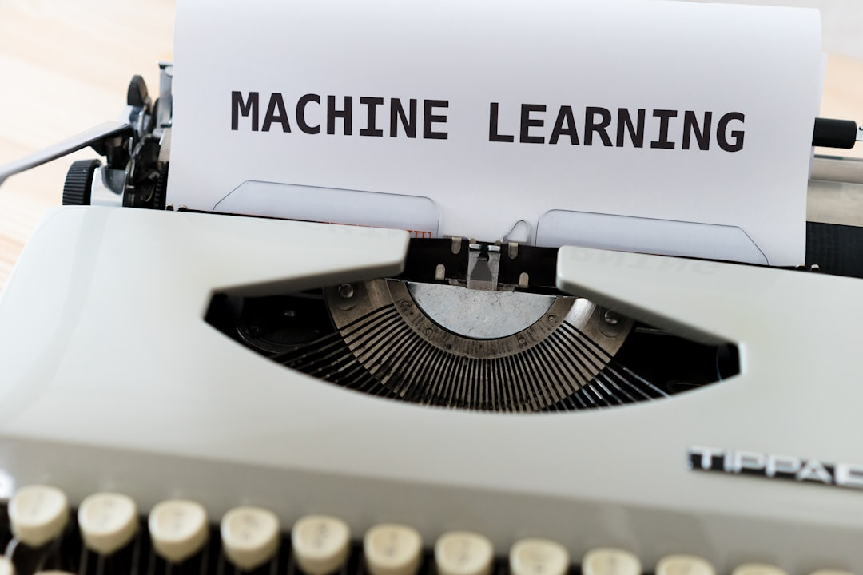
Introduction to Machine Learning - Foundations
Machine learning is a subset of artificial intelligence
Enables systems to learn from data without programming
Types include supervised, unsupervised, and reinforcement learning
Supervised learning uses labeled data for training
Unsupervised learning identifies patterns in unlabeled data
Reinforcement learning uses rewards and penalties for learning
Applications include image recognition and natural language processing
Machine learning algorithms are used in predictive modeling
Data preprocessing is crucial for successful model training
Notes:
When introducing the foundations of machine learning, emphasize the distinction between machine learning and traditional programming. Explain each type of learning with examples, such as supervised learning in image classification, unsupervised learning in customer segmentation, and reinforcement learning in game playing. Discuss the importance of data quality and preprocessing. Ask students to consider real-world applications where machine learning could be applied, and what kind of data would be required for training. Key takeaways should include understanding the basic types of machine learning and their potential applications.

Slide 4
Introduction to Machine Learning - Fundamentals
Machine learning refers to automated data analysis
Enables systems to learn from data without programming
Involves pattern recognition and prediction techniques
Supervised learning uses labeled training data
Unsupervised learning uses unlabeled training data
Reinforcement learning uses rewards and penalties
Neural networks mimic human brain structure
Decision trees represent choices and outcomes
Random forests combine multiple decision trees
Support vector machines find optimal hyperplanes
Notes:
Explain that machine learning is a subset of artificial intelligence, focusing on developing algorithms that allow systems to learn from data. Provide examples of supervised learning, such as image classification, and unsupervised learning, such as customer segmentation. Discuss the importance of reinforcement learning in robotics and game playing. Use the example of a neural network recognizing handwritten digits to illustrate its potential. Ask students to consider how machine learning can be applied to real-world problems, such as predicting stock prices or recommending products. Emphasize the key takeaway that machine learning is a powerful tool for automating data analysis and decision-making.

Slide 5
Types of Learning - Introduction
Machine learning involves supervised learning techniques
Unsupervised learning discovers hidden patterns in data
Semi-supervised learning combines labeled and unlabeled data
Reinforcement learning uses rewards or penalties
Deep learning is a subset of machine learning methods
Transfer learning applies learned models to new tasks
Self-supervised learning uses self-generated supervisory signals
Active learning selects most informative data samples
Online learning updates models with streaming data
Batch learning trains models on entire dataset
Notes:
Explain the different types of learning in machine learning, providing examples of each. Discuss supervised learning with labeled datasets, unsupervised learning for pattern discovery, and semi-supervised learning for combining both. Introduce reinforcement learning and its application in robotics. Emphasize the importance of deep learning and its role in current AI research. Provide examples of transfer learning, such as using pre-trained models for new tasks. Discuss the benefits of self-supervised, active, online, and batch learning. Ask students to consider the differences between these types and how they might apply them in real-world problems. Key takeaways include understanding the variety of machine learning approaches and their applications.

